Slide 1
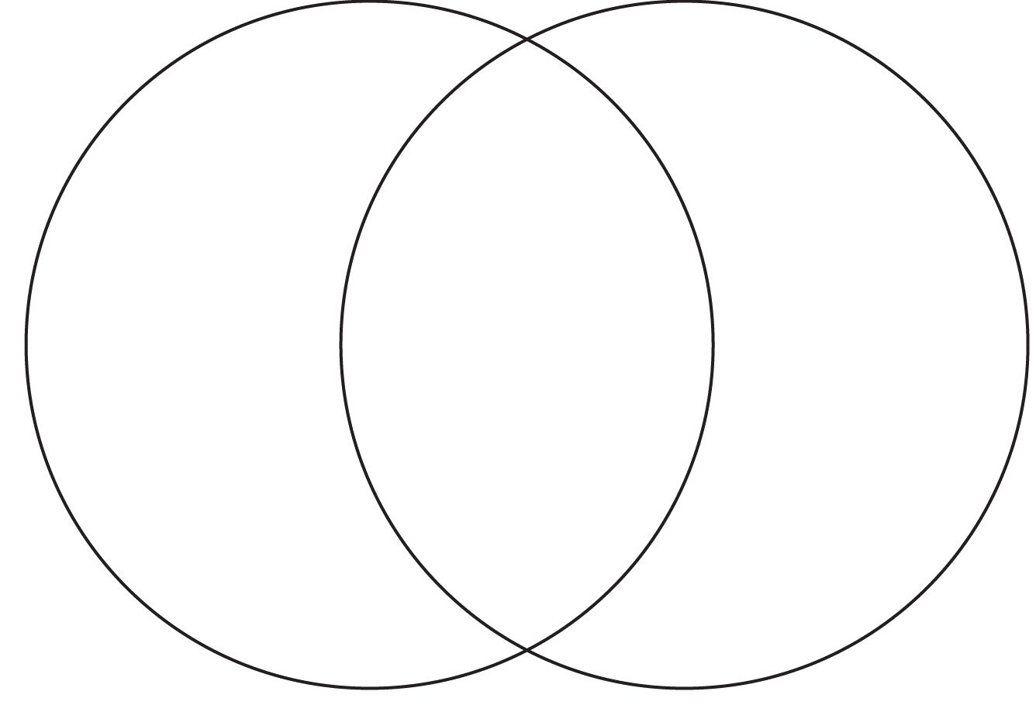
Name _______________
Period______
5 things =15 total

