Slide 1
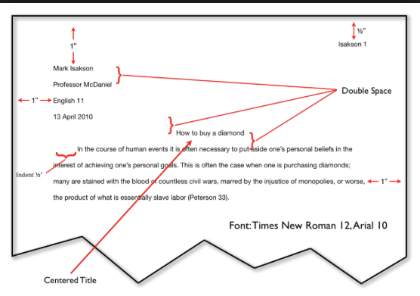
Header
Heading

Slide 2
Smith 1
Header
Last name and Page number

Slide 3
Heading
Your Name
Mrs. Dudek
English 9
8 January 2018
Day Month Year

Slide 4
Title
Font

