Slide 1
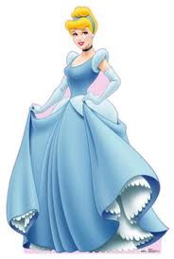
Plot Diagram
Put the elements of plot in the correct order.
1) Cinderella goes to the ball and dances with the prince. | 6) The prince says he will marry the woman whom the slipper fits.
2) A fairy godmother appears and provides Cinderella with clothes, coach and footmen. | 7) Cinderella and the prince marry.
3) Cinderella lives unhappily with her stepsisters and their mother. | 8) The stepsisters prepare for and go to the ball.
4) Cinderella leaves hurriedly at midnight and loses a slipper. | 9) An invitation to the palace ball arrives.
5) They live happily ever after. | 10) The stepsisters try to force their feet into the slipper, but it fits Cinderella.

Slide 2
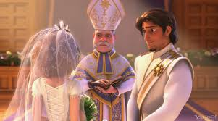
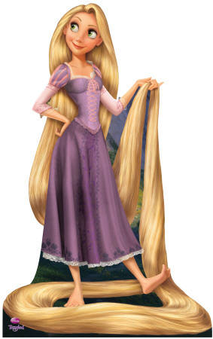
Plot Diagram

